Slide 1
Animation Notes
For Quiz
25 points today

Slide 2
What is animation?
The technique of photographing successive drawings or positions of puppets or models to create
an illusion of movement when the
movie is shown as a sequence.

Slide 3
Name 3 of DISNEYʻS 12 Basic Principles of
Animation
The 12 Principles of Animation
1 Squash and stretch
2 Anticipation
3 Staging
4 Straight Ahead Action and Pose to Pose
5 Follow Through and Overlapping Action
6 Slow In and Slow Out
7 Arc
8 Secondary Action
9 Timing
10 Exaggeration
11 Solid drawing
12 Appeal

Slide 4
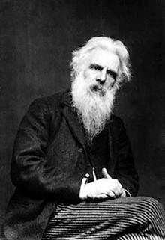
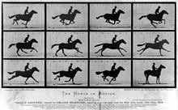
Who was Eadward Muybridge 1878?
What is he known for in animation?
Known for his pioneering work in photographic studies of motion,
Between 1878 and 1884, Muybridge perfected his
method of photographing horses in motion, proving that they do have all four hooves off the ground during their running stride.

Slide 5
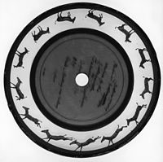
Who was Eadward Muybridge 1878?
What is a Zoopraxiscope?
The zoopraxiscope is an early
device for displaying motion pictures.
Created by photographic pioneer Eadweard Muybridge in 1879, it may be considered the first movie projector. The zoopraxiscope projected images from rotating glass disks in rapid succession to give the impression of motion. The stop-motion images were initially painted onto the glass, as silhouettes. A second series of discs, made in 1892–1894, used outline drawings printed onto the discs photographically, then colored by hand.

Slide 6
Who was Thomas Edison and what did
he invent that changed the history of animation?
Was a businessman and inventor
Invented many things
Edison was granted a patent for the motion picture camera or "Kinetograph". In 1891, Thomas Edison built a Kinetoscope, or peep-hole viewer. This device was installed in penny arcades, where people could watch short, simple films.
The kinetograph and kinetoscope were both first publicly exhibited May 20, 1891.[77]

Slide 7
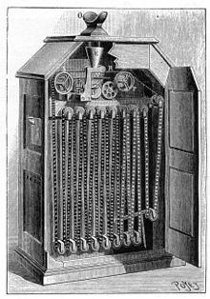
What was the Kinetoscope?
The Kinetoscope is an early motion picture exhibition device. The Kinetoscope was designed for films to be viewed by one individual at a time through a peephole viewer window at the top of the device. The Kinetoscope was not a movie projector but introduced the basic approach that would become the standard for all cinematic projection before the advent of video, by creating the illusion of movement by conveying a strip of perforated film bearing sequential images over a light source with a high-speed shutter.

Slide 8
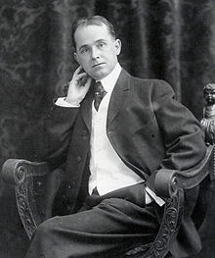
Who was Winsor McCay?
Winsor McCay was an American cartoonist and animator. He is best known for the comic strip Little Nemo (1905–14; 1924–26) and the animated film Gertie the Dinosaur (1914)

Slide 9
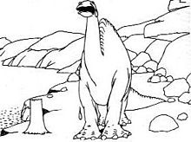
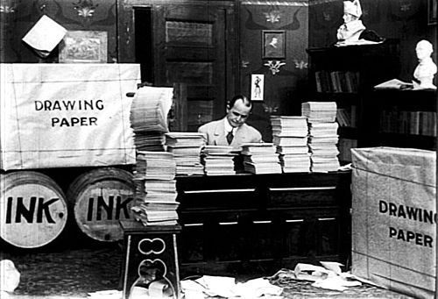
Who was Winsor McCay?
Who/What was Gertie the Dinosaur?
Gertie the Dinosaur was an animated character that debuted in February 1914.
McCay introduced Gertie as "the only dinosaur in captivity", and commanded the animated beast with a whip. Gertie seemed to obey McCay, bowing to the audience, and eating a tree and a boulder, though she had a will of her own and sometimes rebelled.

Slide 10
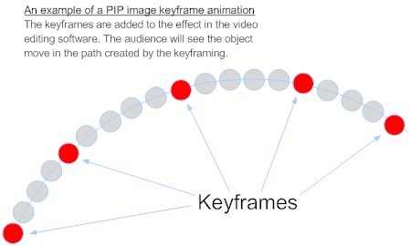
What are Keyframes?
A key frame in animation and filmmaking is a drawing that defines the starting and ending points of any smooth transition. The drawings are called "frames" because their position in time is measured in frames on a strip of film.

